Slide 1
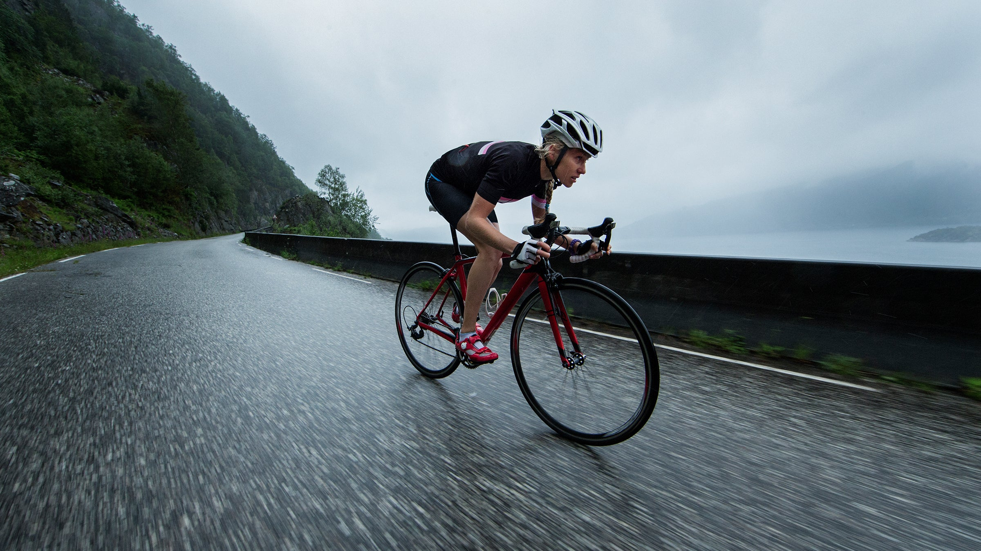
Improving Profits of BikeZ Ltd.
Executive Leadership
Viktoria Samberger

Slide 2
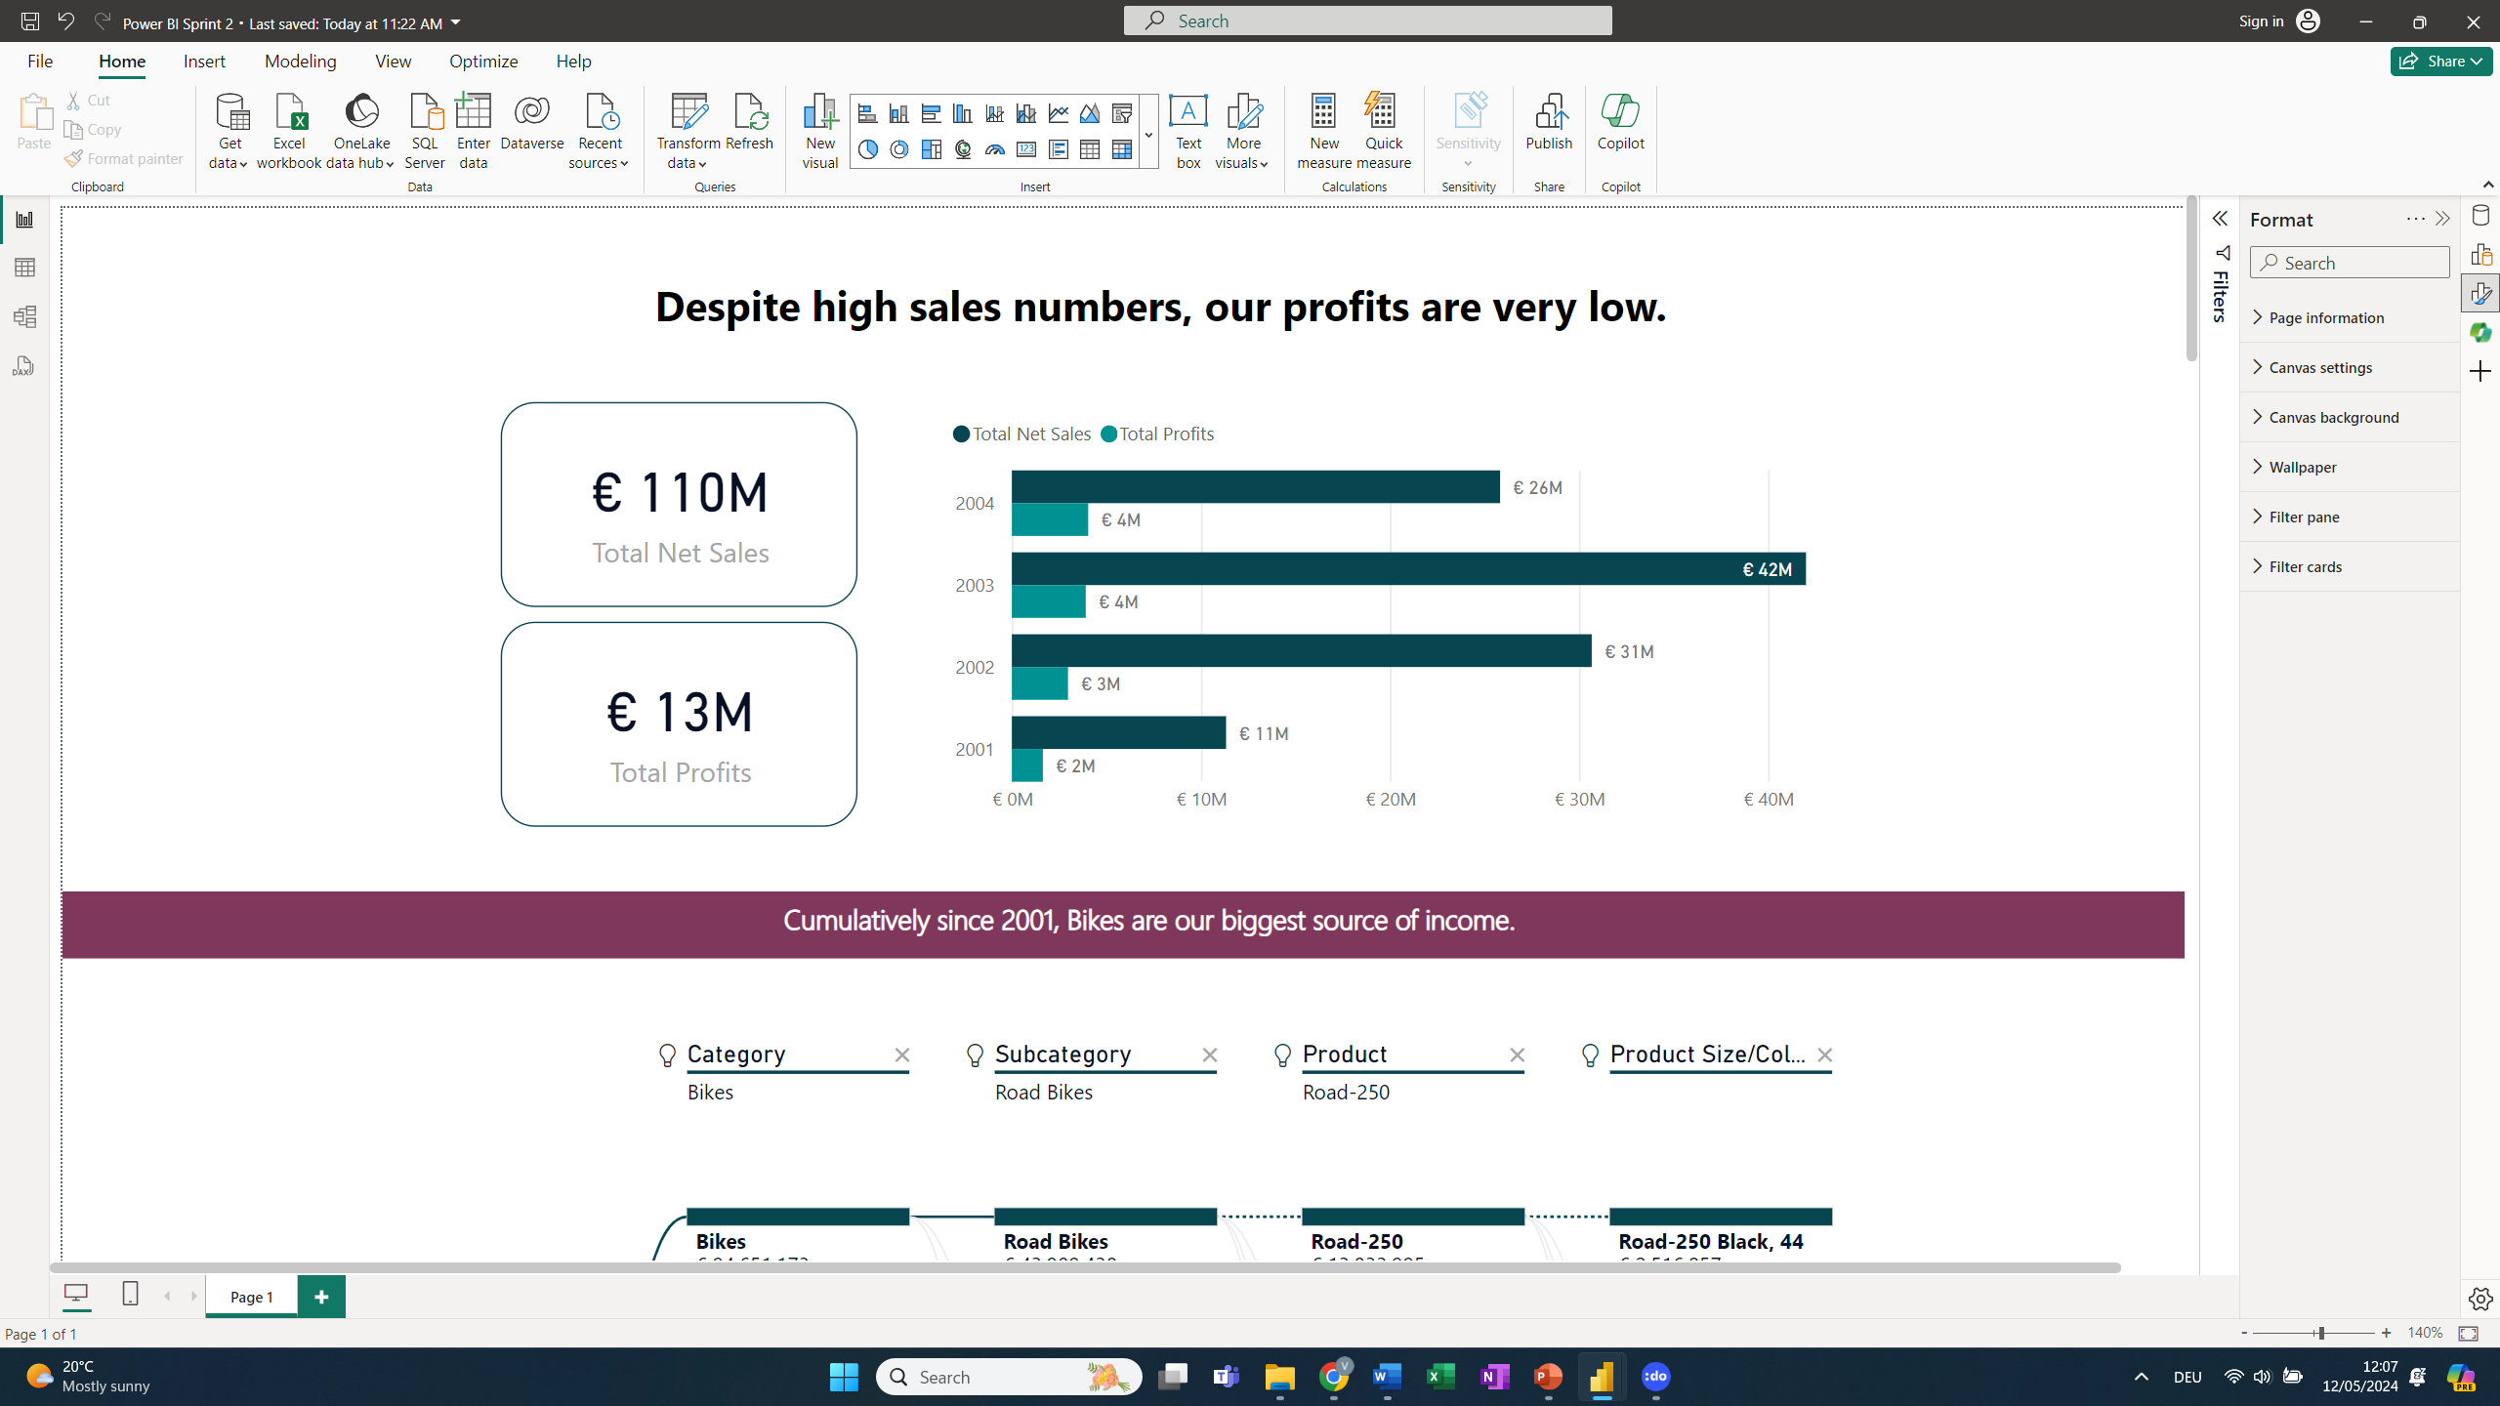
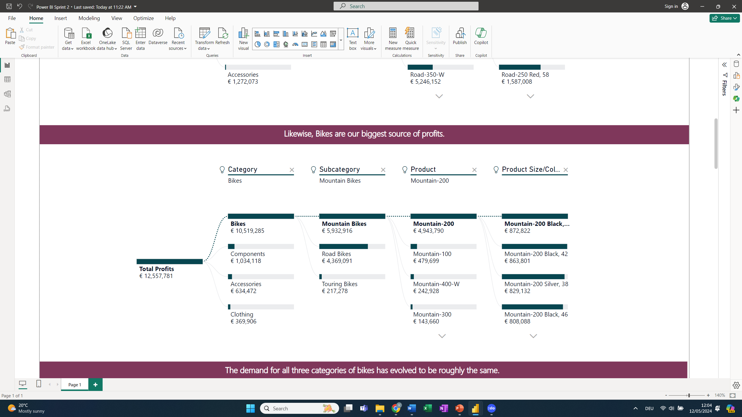
Despite high sales numbers, our profits are very low. Let´s further improve Standard Costs and Sales Efforts of most profitable products.
Executive Summary
Cumulatively since 2001:
Our most profitable Category is ‘Bikes’

Slide 3
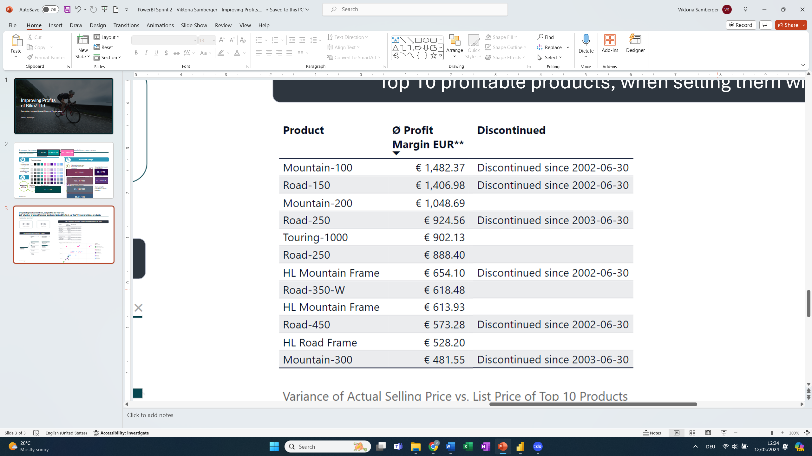
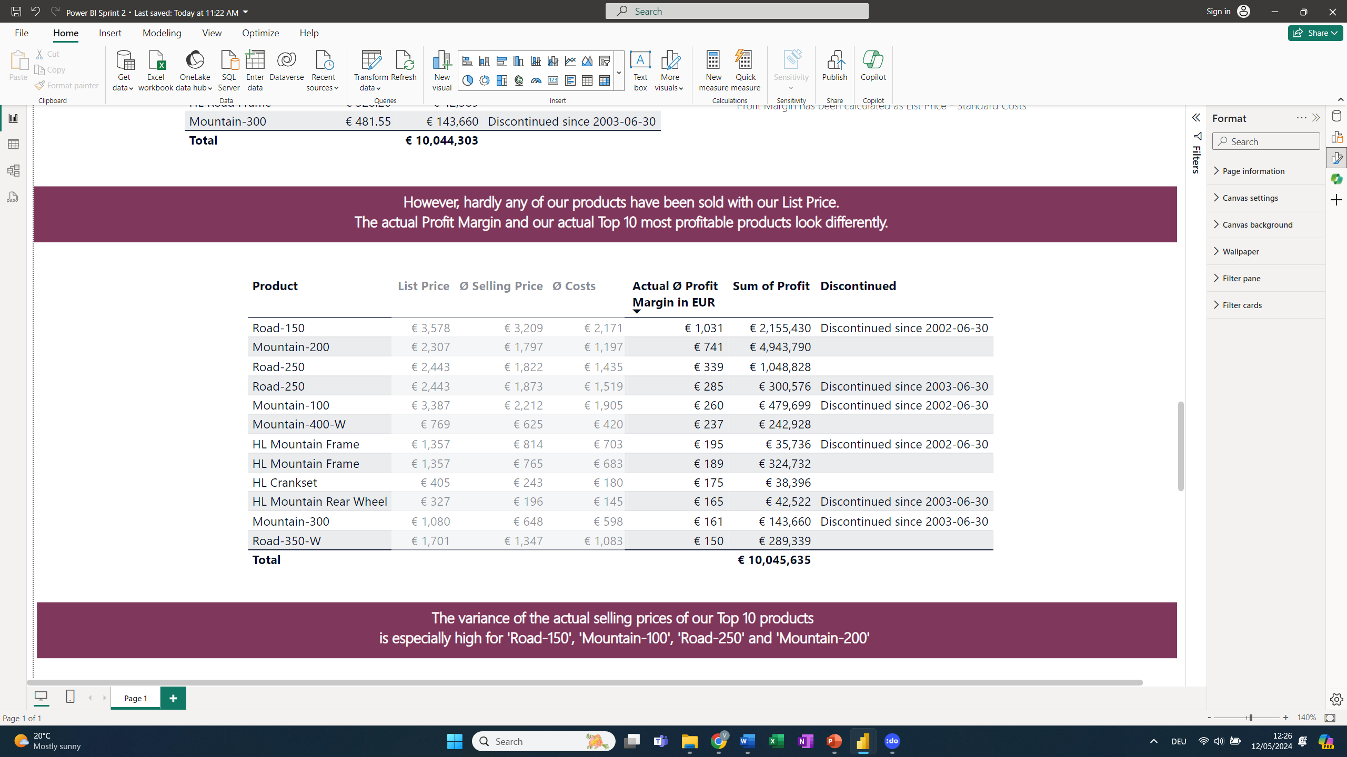
Despite high sales numbers, our profits are very low. Let´s further improve Standard Costs and Sales Efforts of most profitable products.
Executive Summary
Cumulatively since 2001:
Theoretically, our most profitable products are:
However, we often don’t sell with our List Price.
Our actual most profitable products are:
Top 10 profitable products* with List Price
Top 10 profitable products* with actual Selling Price
Our most profitable Category is ‘Bikes’
* The products 'Road-250' and 'HL Mountain Frame' appear twice in the table because: 'Road-250' in the colour red has been discontinued but is still produced in black. The HL Mountain Frame has been discontinued in the sizes 44 and 48 but is continued for other sizes. Consequently, the discontinued versions represent a separate entry in the table.
** Different sizes or colours of the products have slightly different prices and costs. Therefore, the average profit margin per product is shown in the table.
To improve profits, it is recommended to….
1
2
3

Slide 4
Despite high sales numbers, our profits are very low. Let´s further improve Standard Costs and Sales Efforts of most profitable products.
Executive Summary
Cumulatively since 2001:
Theoretically, our most profitable products are:
However, we often don’t sell with our List Price.
Our actual most profitable products are:
Top 10 profitable products* with List Price
Top 10 profitable products* with actual Selling Price
Our most profitable Category is ‘Bikes’
* The products 'Road-250' and 'HL Mountain Frame' appear twice in the table because: 'Road-250' in the colour red has been discontinued but is still produced in black. The HL Mountain Frame has been discontinued in the sizes 44 and 48 but is continued for other sizes. Consequently, the discontinued versions represent a separate entry in the table.
** Different sizes or colours of the products have slightly different prices and costs. Therefore, the average profit margin per product is shown in the table.
To improve profits, it is recommended to….
1
Focus sales efforts on selling our most profitable products at our List Price
2
3

Slide 5
Despite high sales numbers, our profits are very low. Let´s further improve Standard Costs and Sales Efforts of most profitable products.
Executive Summary
Cumulatively since 2001:
Theoretically, our most profitable products are:
However, we often don’t sell with our List Price.
Our actual most profitable products are:
Top 10 profitable products* with List Price
Top 10 profitable products* with actual Selling Price
Our most profitable Category is ‘Bikes’
* The products 'Road-250' and 'HL Mountain Frame' appear twice in the table because: 'Road-250' in the colour red has been discontinued but is still produced in black. The HL Mountain Frame has been discontinued in the sizes 44 and 48 but is continued for other sizes. Consequently, the discontinued versions represent a separate entry in the table.
** Different sizes or colours of the products have slightly different prices and costs. Therefore, the average profit margin per product is shown in the table.
To improve profits, it is recommended to….
1
Focus sales efforts on selling our most profitable products at our List Price
2
Decrease Standard Costs of Top 10 Products and re-evaluate a relaunch of discontinued bikes (e.g. Road-150)
3

Slide 6
Despite high sales numbers, our profits are very low. Let´s further improve Standard Costs and Sales Efforts of most profitable products.
Executive Summary
Cumulatively since 2001:
Theoretically, our most profitable products are:
However, we often don’t sell with our List Price.
Our actual most profitable products are:
Top 10 profitable products* with List Price
Top 10 profitable products* with actual Selling Price
Our most profitable Category is ‘Bikes’
* The products 'Road-250' and 'HL Mountain Frame' appear twice in the table because: 'Road-250' in the colour red has been discontinued but is still produced in black. The HL Mountain Frame has been discontinued in the sizes 44 and 48 but is continued for other sizes. Consequently, the discontinued versions represent a separate entry in the table.
** Different sizes or colours of the products have slightly different prices and costs. Therefore, the average profit margin per product is shown in the table.
To improve profits, it is recommended to….
1
Focus sales efforts on selling our most profitable products at our List Price
2
Decrease Standard Costs of Top 10 Products and re-evaluate a relaunch of discontinued bikes (e.g. Road-150)
3
Consider eliminating low-performing categories ‘Clothing’ and ‘Accessories’ to slim down costs

Slide 7
Despite high sales numbers, our profits are very low. Let´s further improve Standard Costs and Sales Efforts of most profitable products.
Executive Summary
Cumulatively since 2001:
Theoretically, our most profitable products are:
However, we often don’t sell with our List Price.
Our actual most profitable products are:
Top 10 profitable products* with List Price
Top 10 profitable products* with actual Selling Price
Our most profitable Category is ‘Bikes’
* The products 'Road-250' and 'HL Mountain Frame' appear twice in the table because: 'Road-250' in the colour red has been discontinued but is still produced in black. The HL Mountain Frame has been discontinued in the sizes 44 and 48 but is continued for other sizes. Consequently, the discontinued versions represent a separate entry in the table.
** Different sizes or colours of the products have slightly different prices and costs. Therefore, the average profit margin per product is shown in the table.
To improve profits, it is recommended to….
1
Focus sales efforts on selling our most profitable products at our List Price
2
Decrease Standard Costs of Top 10 Products and re-evaluate a relaunch of discontinued bikes (e.g. Road-150)
3
Consider eliminating low-performing categories ‘Clothing’ and ‘Accessories’ to slim down costs

Slide 8
Thank You for your attention. Any Questions?

Slide 9
Finance Deep-Dive: Improving Profits of BikeZ Ltd.
Finance Department
Viktoria Samberger

Slide 10
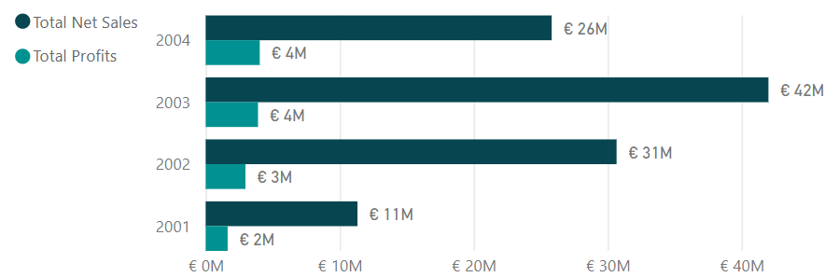
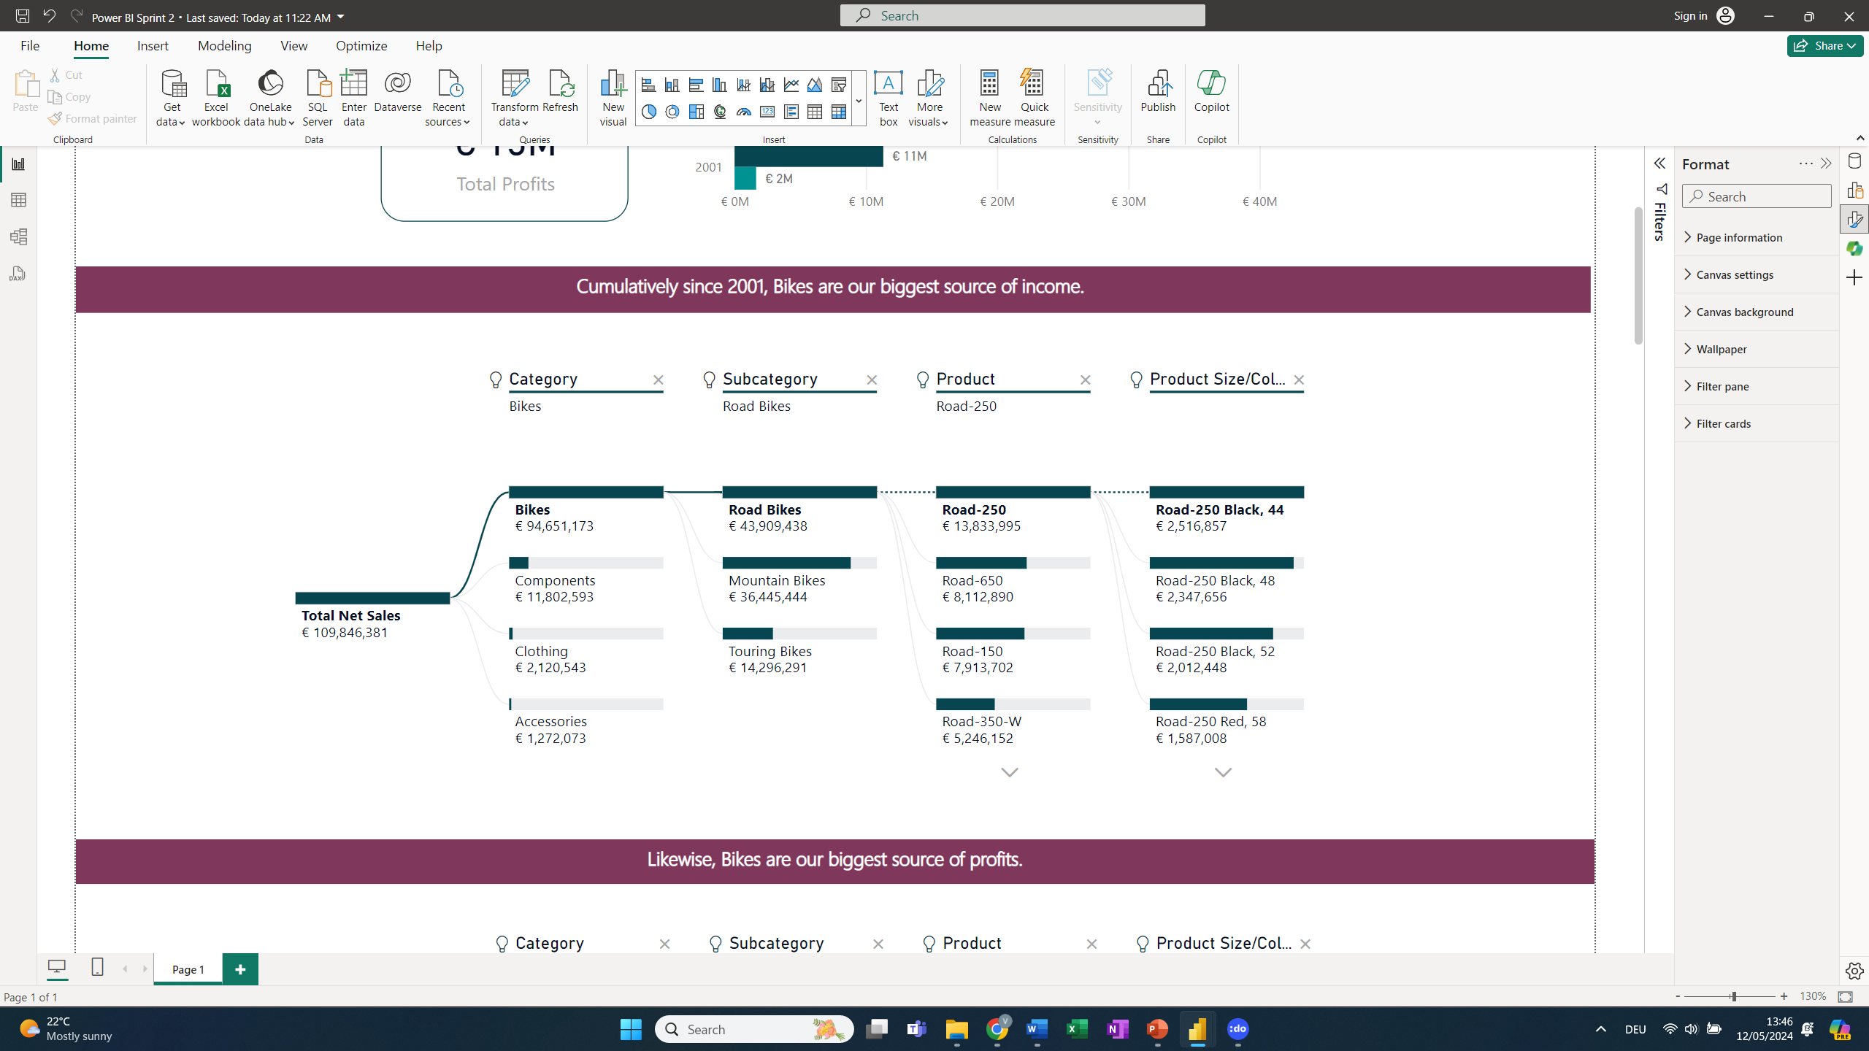
Despite high sales numbers, our profits are very low.
Deep-Dive Profits Evaluation
Cumulatively since 2001:
H1
2004e tbd
2004e tbd
Our biggest source of income is the Category ‘Bikes’
Likewise, our most profitable Category is ‘Bikes’
Cumulatively since 2001:
Cumulatively since 2001:

Slide 11
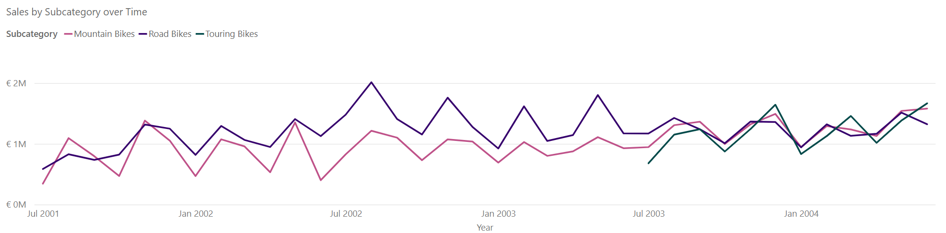
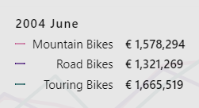
The demand for all three categories of bikes has evolved to be roughly the same.
Deep-Dive Profits Evaluation

Slide 12
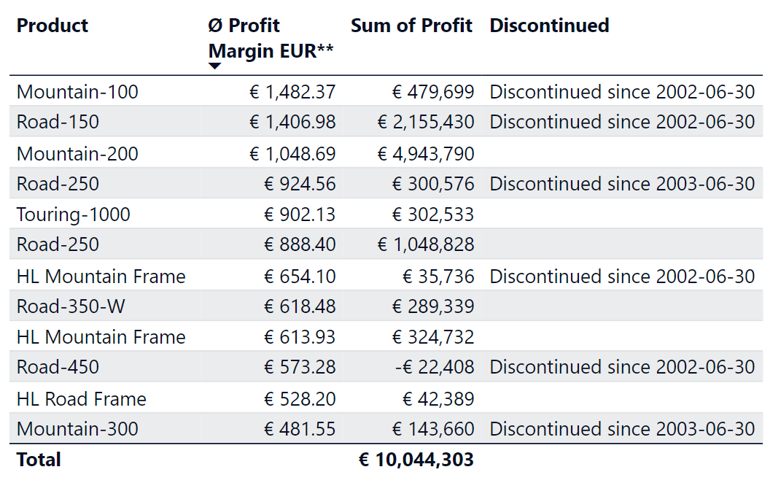
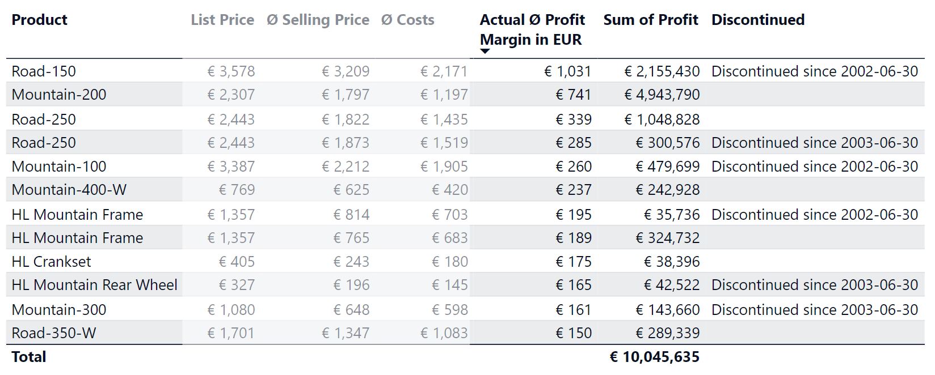
The Top 10 most profitable products depend on final Selling Price (vs. List Price) however, 4 out of our Top 10 have already been discontinued.
Deep-Dive Profits Evaluation
Theoretically, our most profitable products are:
However, we often don’t sell at our List Price and therefore,
our actual most profitable products are:
Top 10 profitable products* with List Price
Top 10 profitable products* with actual Selling Price
Cumulative numbers since 2001.
* The products 'Road-250' and 'HL Mountain Frame' appear twice in the table because: 'Road-250' in the colour red has been discontinued but is still produced in black. The HL Mountain Frame has been discontinued in the sizes 44 and 48 but is continued for other sizes. Consequently, the discontinued versions represent a separate entry in the table.
** Different sizes or colours of the products have slightly different prices and costs. Therefore, the average profit margin per product is shown in the table.

Slide 13
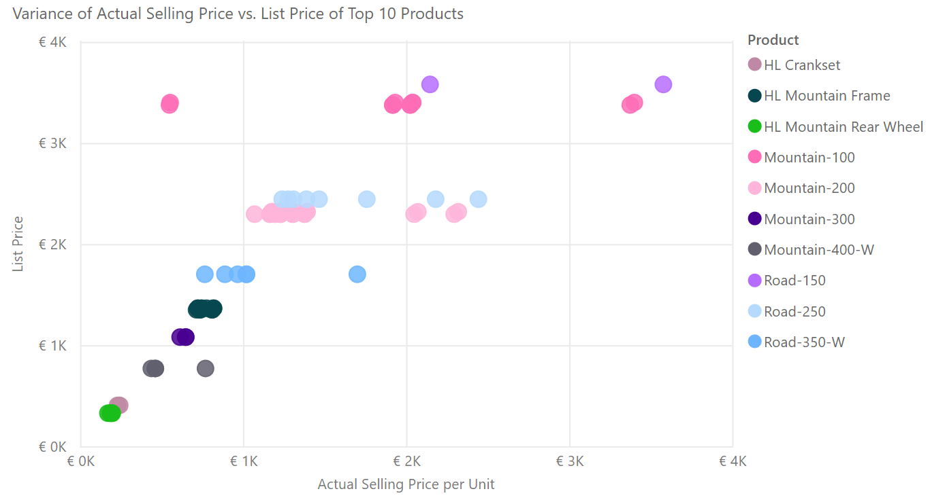
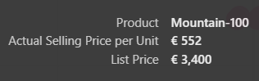
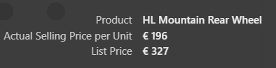
The variance of the actual selling prices of our Top 10 is especially high for ‘Road-150’, ‘Mountain-100’, ‘Road-250’ and ‘Mountain-200’
Deep-Dive Profits Evaluation
Variance of Actual Selling Price* vs. List Price* of Top 10 Products
For example:
For example:
*Cumulative Numbers since 2001

Slide 14
To improve profits, it is recommended to…
Deep-Dive Profits Evaluation
1
Focus sales efforts on selling our products at our List Price.
Refocus our sales efforts on Top 10 most profitable products.
2
Further decrease Standard Costs for our Top Performing Products to improve Profit Margins.
Re-evaluate whether discontinued products (such as Road-150) should be relaunched.
3
Consider eliminating the low-performing categories 'Clothing' and 'Accessories' to slim down inventory-, operation- and employee costs in order to improve profits.
Keep 'Components' as we need the parts for our bike production anyway and therefore this category doesn't cause additional costs.

Slide 15
Thank You for your attention. Any Questions?

Slide 16
Appendix: PowerBI data model and SQL queries
Viktoria Samberger

Slide 17
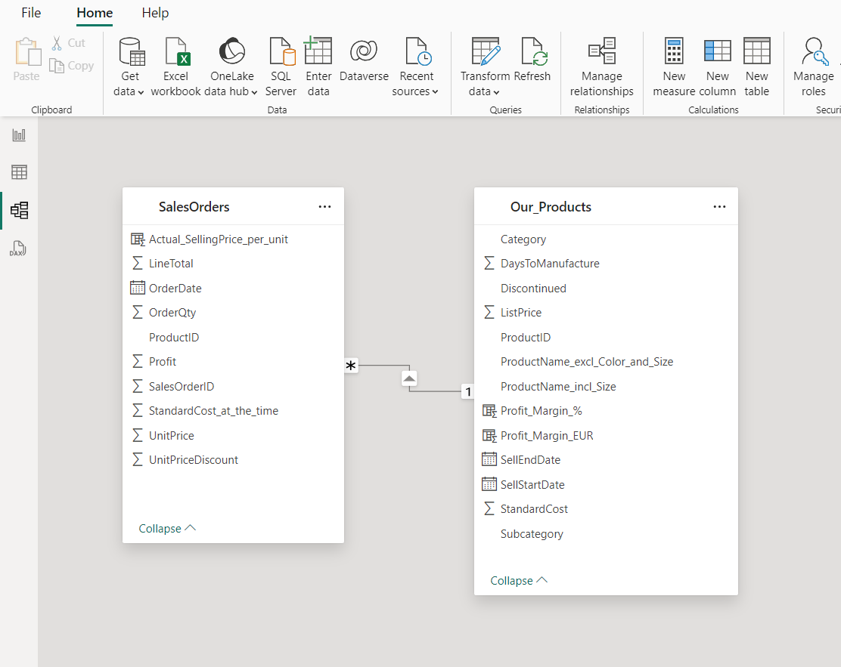
PowerBI data model

Slide 18
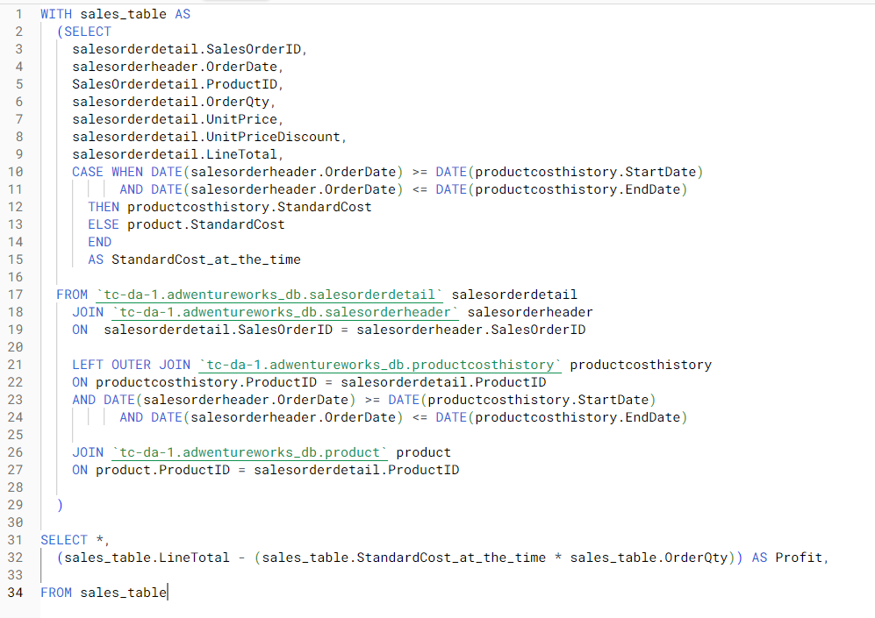
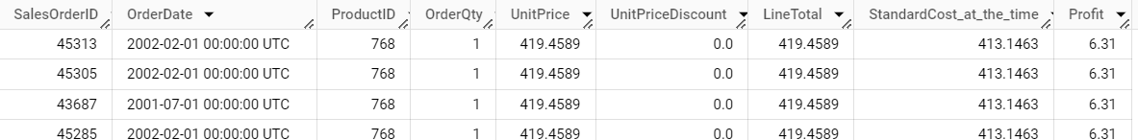
SalesOrders Table
Query
Result

Slide 19
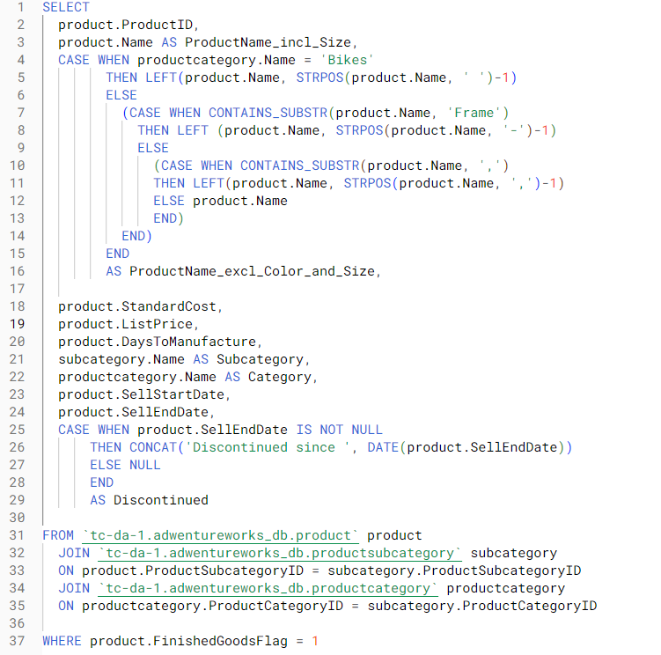
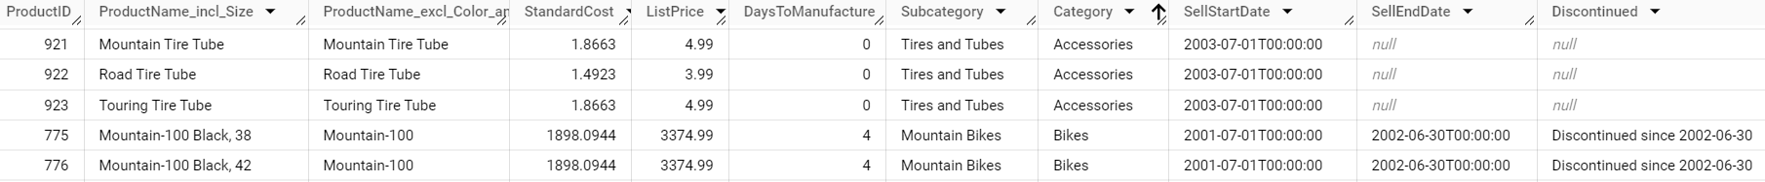
Our_Products Table
Query
Result

